Slide 1
Year 9 Mathematics
Review of Perimeter and Area

Slide 2
Review of Perimeter and Area
Learning Intentions
Success Criteria
By the end of this lesson, students will be able to:
Recall facts about converting measurements
Define perimeter and area
Sketch a range of shapes accurately
I will know that I have been successful if I can:
Participate fully in the lesson in a mature and respectful
Identify areas of understanding and prioritize revision of past topics.

Slide 3
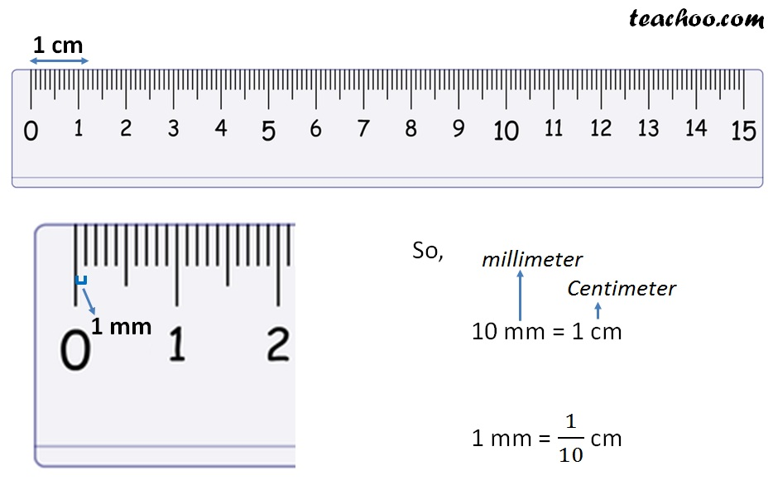
24
7
30
Topic: Revision of Perimeter and Area
EQ: How do I find the perimeter and area of 2D shapes?
cm and mm
What are units?
Linear (Straight line) measurements have 1 direction. They are a direct conversion.
1mm is 10 times smaller than 1cm, so you need 10 times more mm to make the same length.
1cm is 10 times larger than 1mm, so you need 10 times fewer cm to make the same length.

Slide 4
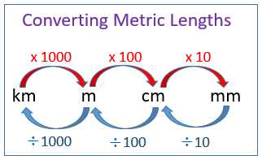
24
7
30
Topic: Revision of Perimeter and Area
EQ: How do I find the perimeter and area of 2D shapes?
How do I convert units of length?

Slide 5
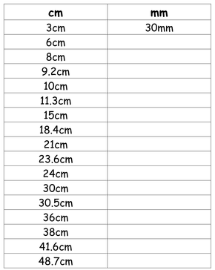

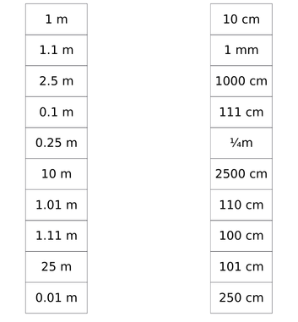
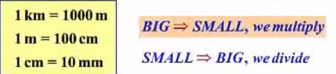
Conversion practice
Copy and complete this table
Match the equal measurements

Slide 6
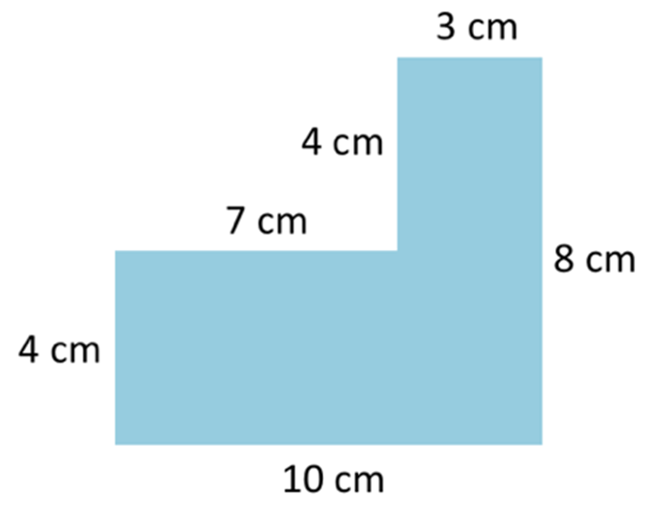
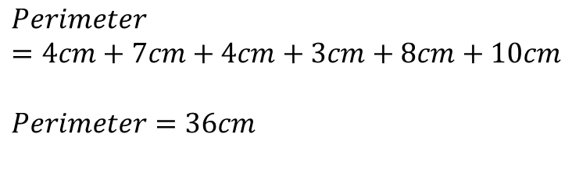
24
7
30
Topic: Revision of Perimeter and Area
EQ: How do I find the perimeter and area of 2D shapes?
What is Perimeter?
Perimeter is the length around the outside edge of the shape. It is a linear (one dimensional) measurement so the units are always mm, cm, m, km etc.
To determine the perimeter:
Add up the lengths of each side
Use an appropriate formula
Use your knowledge of shapes to help
$$Perimeter=4cm+7cm+4cm+3cm+8cm+10cm$$
$$Perimeter=36cm$$

Slide 7
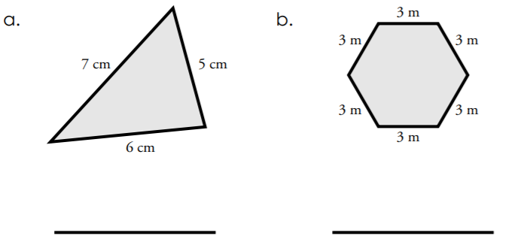
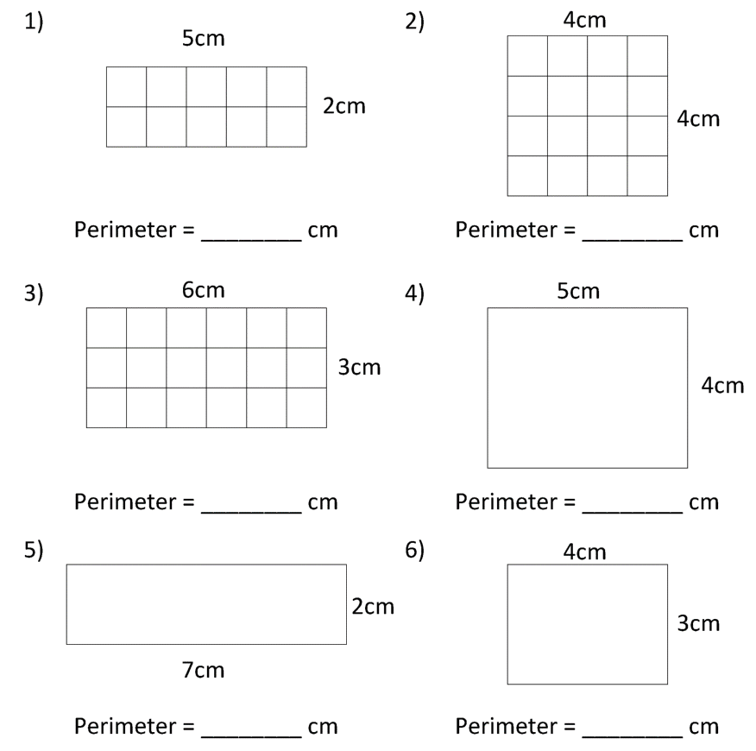
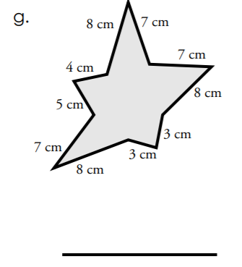
Perimeter Practice

Slide 8
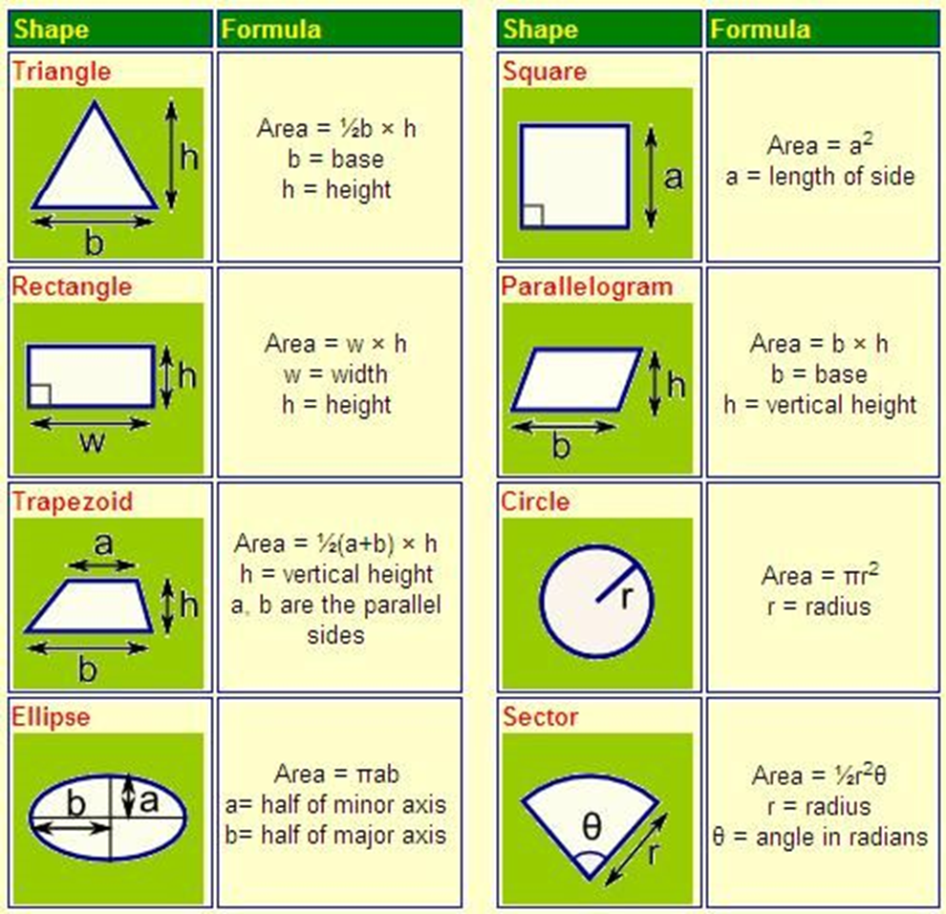
24
7
30
Topic: Revision of Perimeter and Area
EQ: How do I find the perimeter and area of 2D shapes?
What is area?
Area is the amount of flat space a 2-dimensional shape takes up. It is a 2-dimensional measurement so will be in square units, mm², cm², m², km² etc.
To determine area, you need to apply a specific formula depending on the shape.

Slide 9
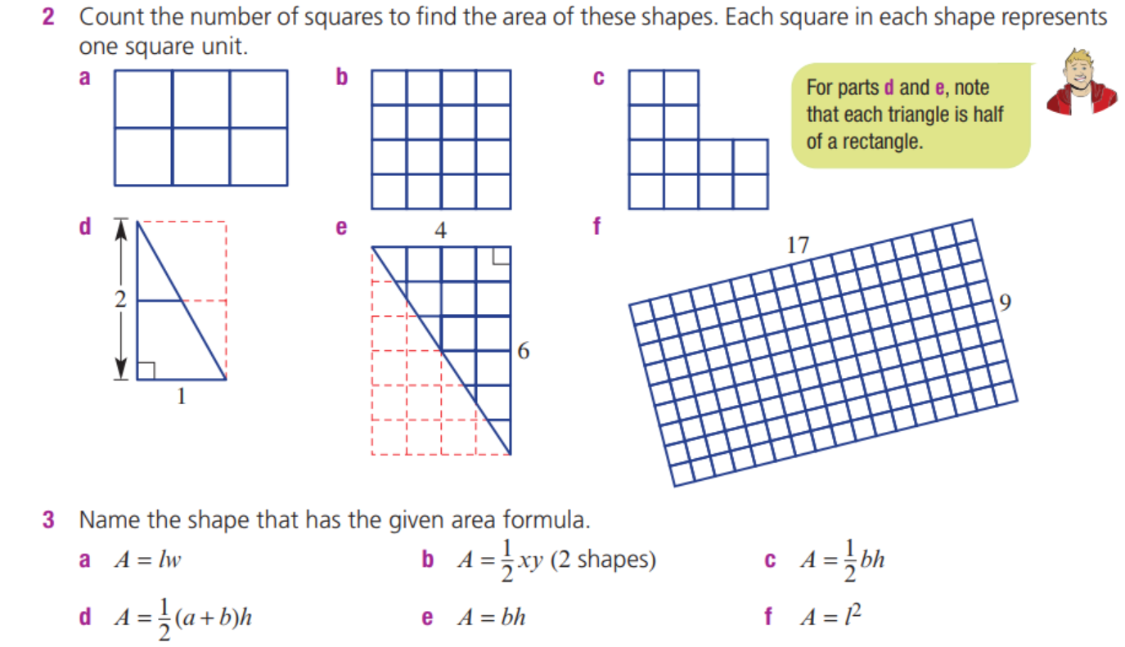

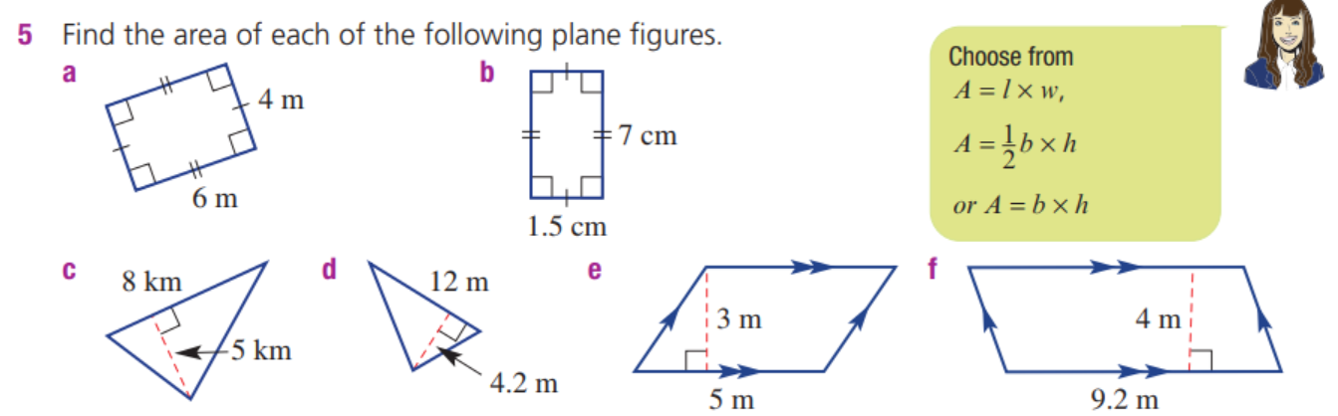
Area Practice

Slide 10
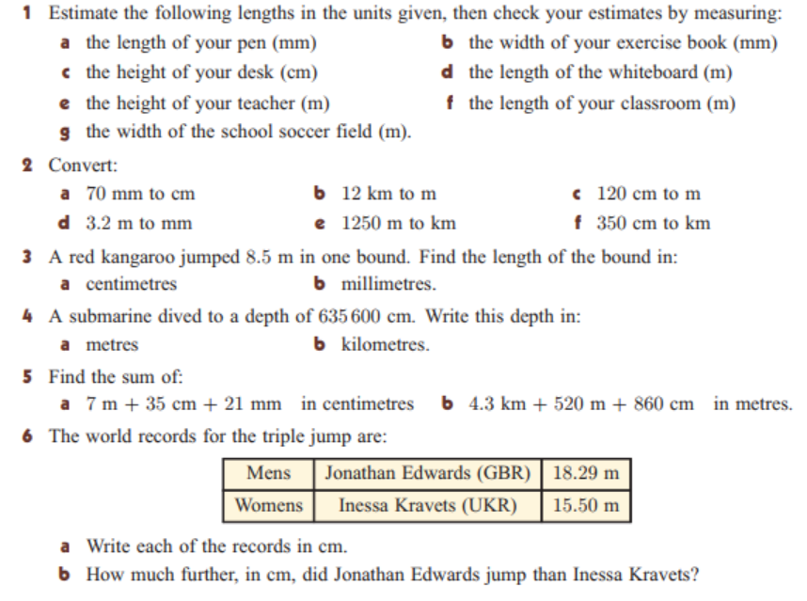
Practise:

Slide 11
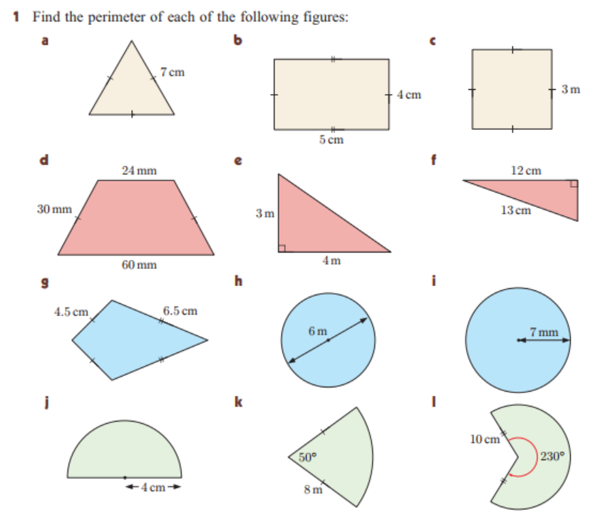
Practise:

Slide 12
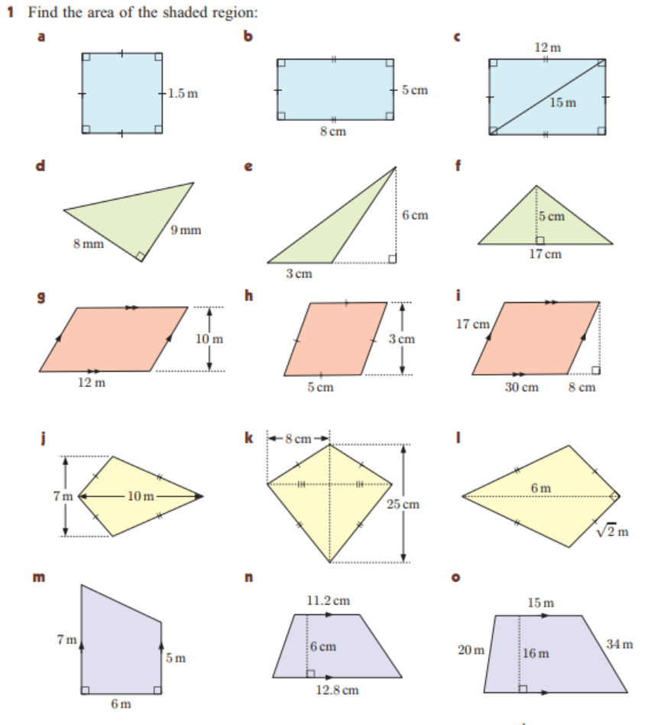
Homework

